Slide 1


Effecient SimScape to Python Simulation
Institute of Industrial Automation
and Software Engineering
Examiner : Jun.-Prof. Dr.-Ing. Andrey Morozov Supervisor : Joachim Grimstad, M.Sc.Ing
Research Project 3639

Slide 2
Agenda
Objective
Project Requirements
Existing Methods
Literature Survey
Introduction
Project Definition
Motivation
Research Question
Proposed Concept
Simulink – C- Python
Methodology
How to Achieve ?
Comparison and Evaluation
Is it better ?

Slide 3
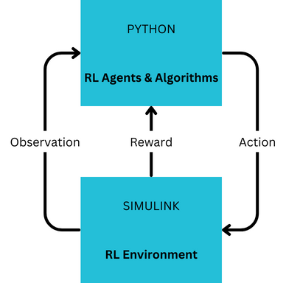
Introduction
MBSE : Used to analyze complex systems for design, verification and validation activities accurately before implementation using computer-based models and simulations.
RL involves iterative communication between environments and agents which gives the basis for the learning for the model using reward based system.
This project is based out of a RL environment modelled using the concept of MBSE in MATLAB Simulink.
MBSE – Model Based Systems Engineering
RL – Reinforcement Learning

Slide 4
Motivation
Agents in Python need to communicate with the learning environment modelled in Simulink.
The integration of Python and Simulink SimScape is necessary to harness the strengths of both. Combining Python's adaptability and SimScape's system modelling can lead to more effective RL applications.
Exisiting algorithm for communication have limitations:
Low speed for data exchange
Slow execution time
Unstable Connections

Slide 5


Objective
Aims to propose a better integration strategy which addresses the bottlenecks of the existing conventional approach
Establish a framework that helps in an effective workflow for system modelling, simulation, and analysis.
Compare the performance of the devised solution.
?
Pictures licensed by CC BY-NC

Slide 6
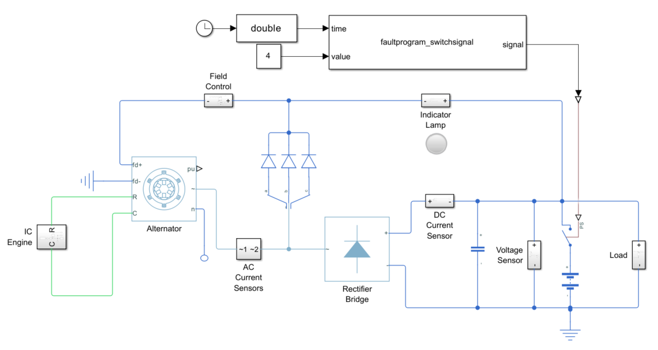
Existing Methods
Python Importer
Embedding the required python script as a block in Simulink.

Slide 7
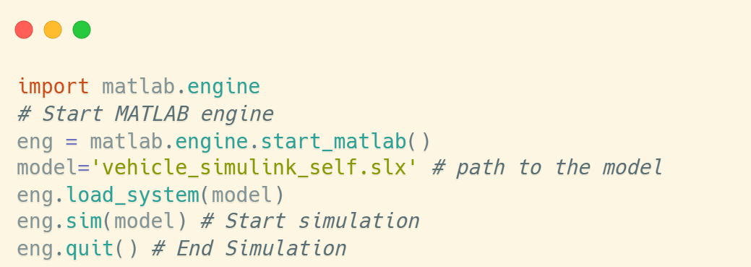
Existing Methods
Matlab Engine
Using matlab engine API library in Python.
Send/Recieve data from workspace
Start/Stop/Pause Simulations
Execute Call backs

Slide 8
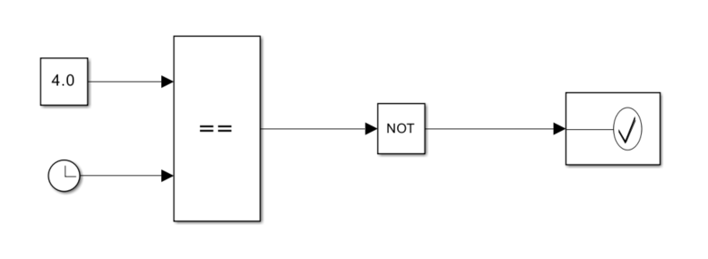
Existing Method
Using Assertion Block to Alter Parameters
Call back executed : set_param('vehicle_simulink_self/Constant','Value','0’)
No Communication with Python. Can be used in combination with matlab engine

Slide 9
Proposed Concept
Simulink - C - Python
Simulink Model
Embedded Coder
C code dll file
ctypes
Python Script
dll – Dynamic Link Library
ctypes – Library in Python

Slide 10

Prerequisites/Tools Required
Matlab Simulink
Embedded Coder
Model Discretizer
Python with libraries
ctypes
os
pefile
matplotlib
Other libraries Numpy,Pandas etc.. for data processing
MinGW-W64 C/C++ Compiler
Preferred IDE for Python Programming (PyCharm, Visual Studio…)
This Photo licensed under CC BY-SA

Slide 11
Methodology
Discretize Model
Model Discretizer Toolbox
Chose Appropriate Coder Settings
Set parameters and Signals
ExportedGlobal Type
Shared Library Mode
Function Type
Dll File Generation
Code Generation
Code Building
Write Python Script
Declare Classes if Needed
Invoke the Three Functions

Slide 12
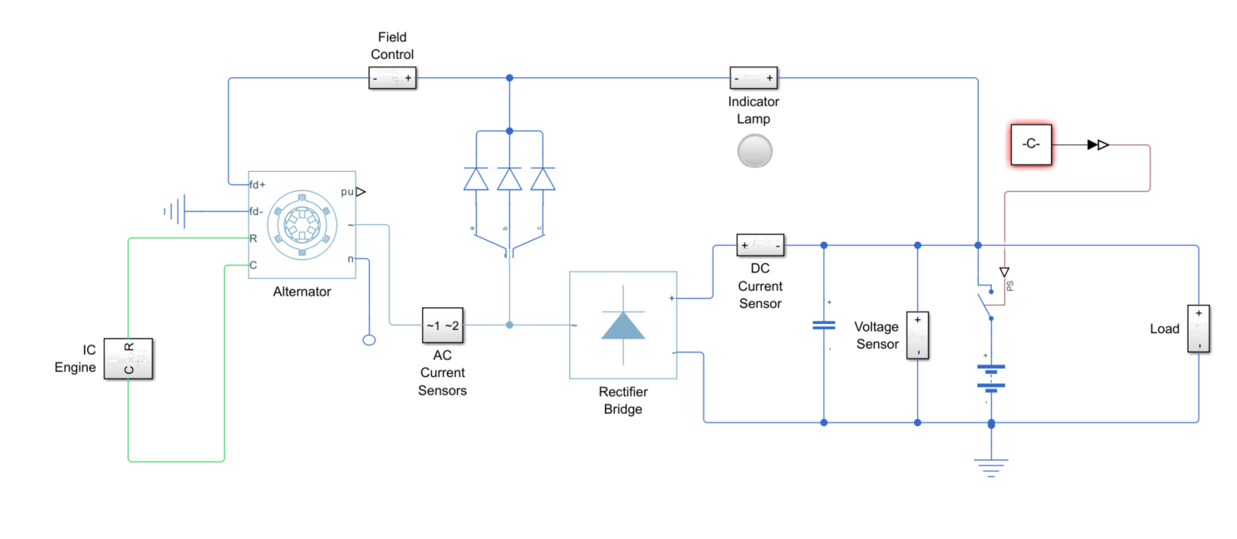
Model Under Test
Vehicle Electrical System
Tunable Parameter – Constant to Control the Switch
Measured Signals – Indicator Lamp Signal and DC Current Sensor
Both set as ‚ExportedGlobal‘ type variable

Slide 13
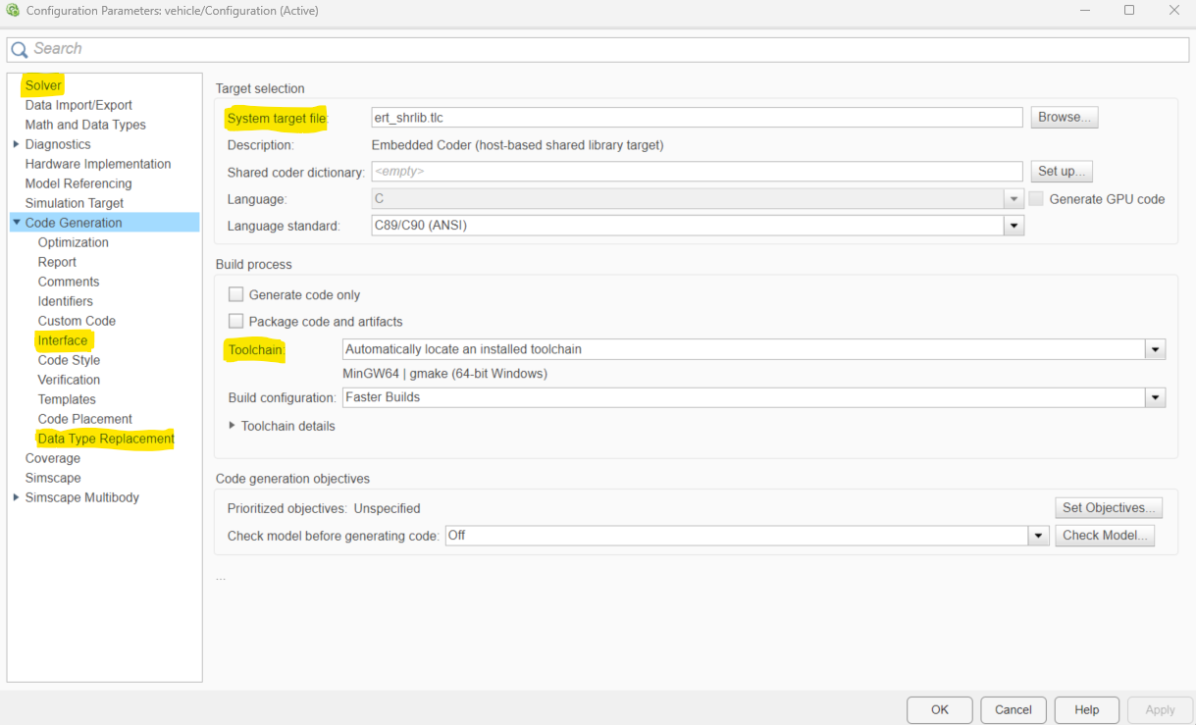
Generating the C Code /dll File
Solver
Solver Type (Fixed Step)
Step-Size
Embedded Coder Toolbox
Code Generation
System target file
Compiler details
Interface
Reusable/Non-Reusable Functions
Variable type support
Array Layouts
Data Type Replacement
Use ctypes data type (coder typedefs)

Slide 14
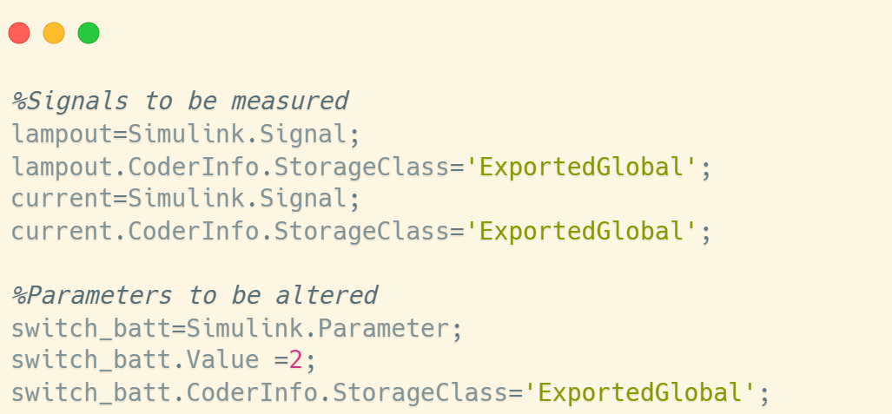
Setting Tunable Parameters and Signals
Set as type ‚ExportedGlobal‘
Model ready: Click Generate Code and then Build.
Dll file is generated in the root folder

Slide 15
Understanding the Generated C Code
ert_main.c
The main file from where all other required functions are invoked
To be mimicked in python
modelname.c
Contains the required functions for the simulation to happen
Contains all global variables that can be accessed from the dll file
modelname.h
Contains Structures
Data types
Initialize(), step() and terminate()
Main File
Model Files

Slide 16
Writing Python Script
Import dll using ctypes
Import the 3 required functions, parameters and signals into local variables.
Declare Classes (For reusable type functions)
From modelname.h file redefine strucutres as classes. Skip this step for non reusable functions.
Initialize the model
Invoke the step function and loop it for simulation time with sample as step size.
Step the model
Invoke initiliaize() function to start the process.
Update required parameters and measure signals in the step loop.
Update and Measure
Terminate
Terminates the model. Kills all temporary constructuors created internally.

Slide 17
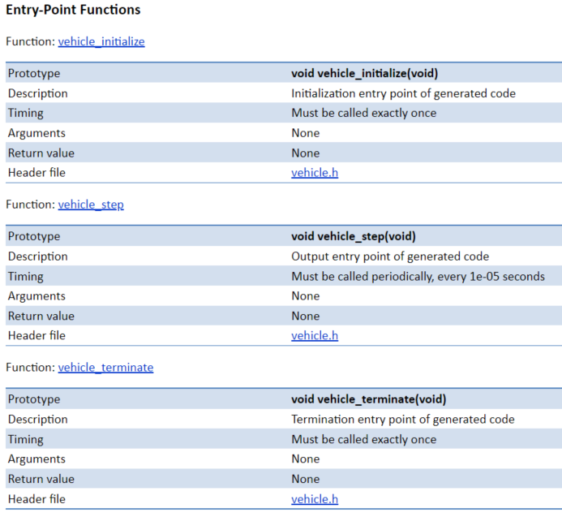
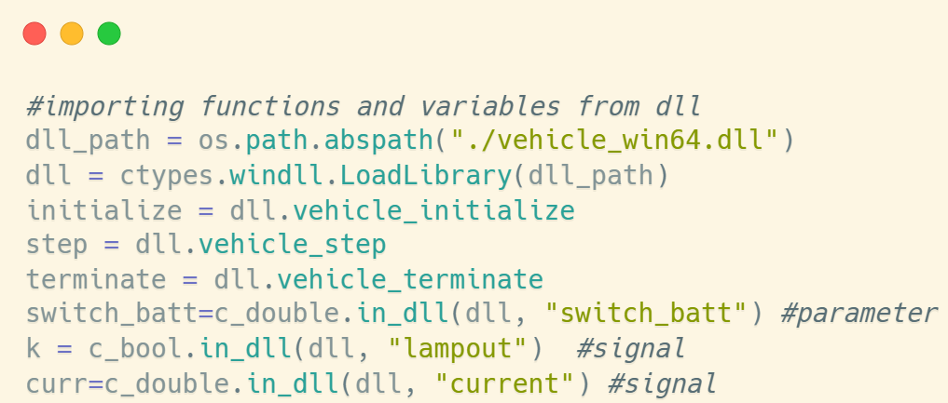
Importing dll file
Using ctypes library
Code generation report
Python script

Slide 18
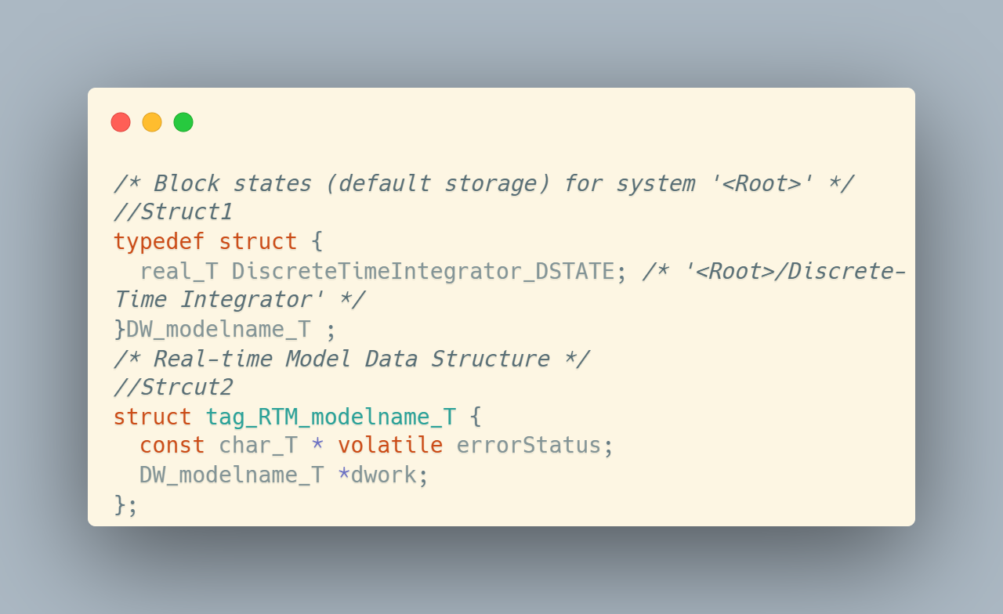
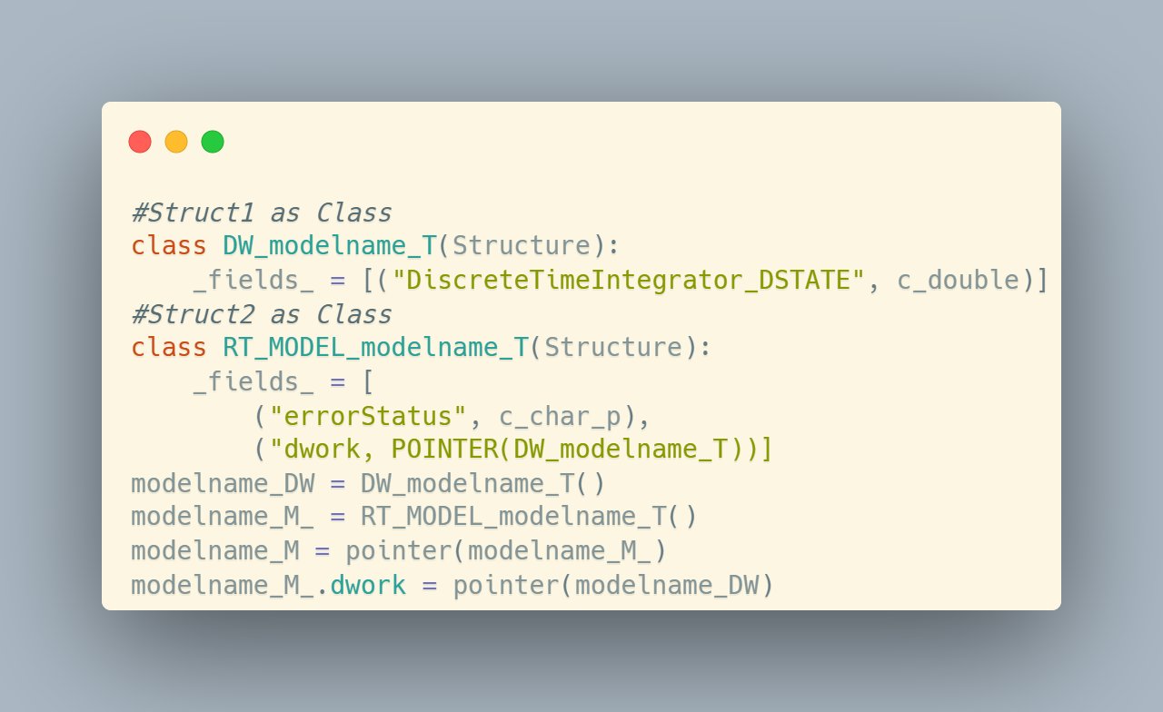
Declaring Classes
For Reusable Function types
Structure Definition in c file
Equivalent class in python script

Slide 19
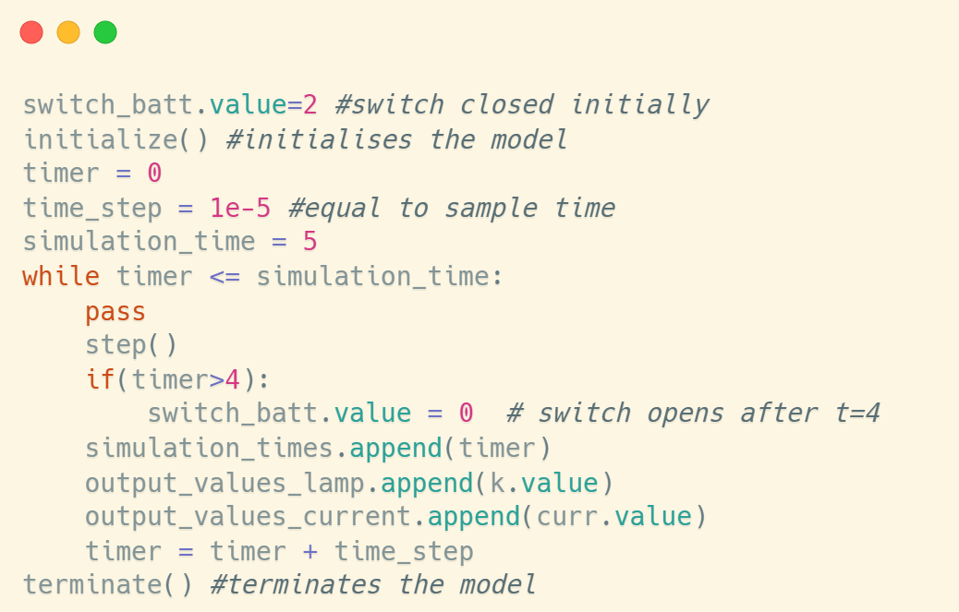
Running the Simulation
Initialize, step, measure, terminate
Data analysis and plotting can be done after this step

Slide 20
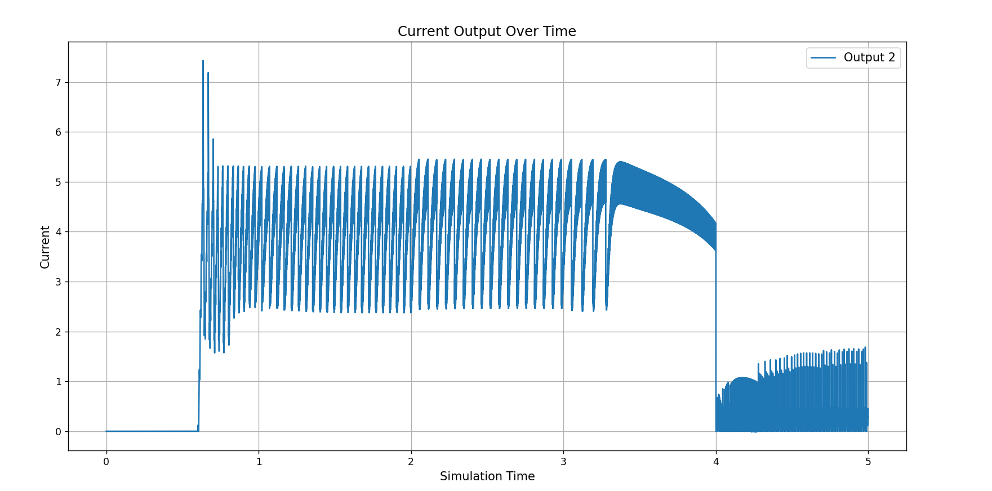
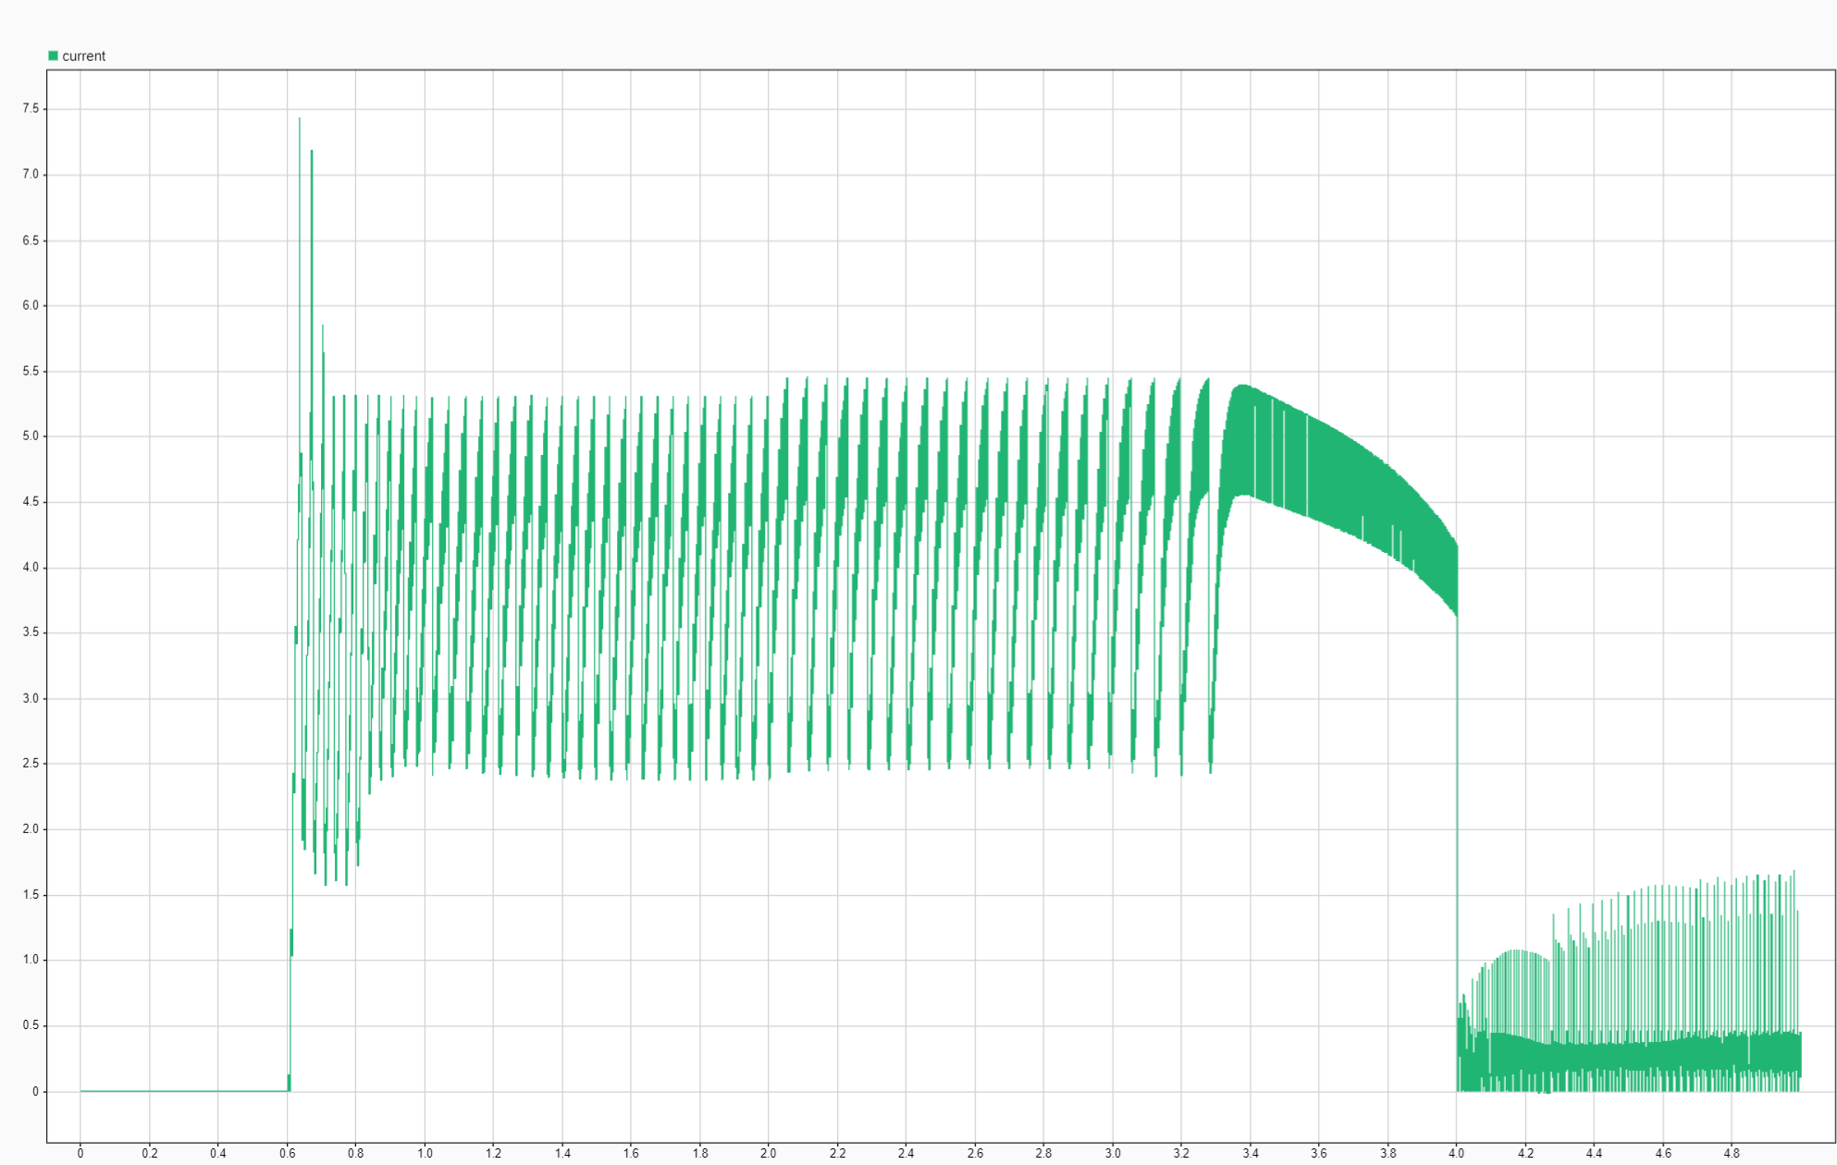
Output Evaluation
Accuracy
Python Output
Simulink Output

Slide 21
Output Evaluation
Execution Time

Slide 22
Comparison Against Existing Methods
Python Importer
F: Difficult for parameter updation
U: Well established documentation
MATLAB Engine
F: Difficult to establish communication
U: Documentation available
Python to C Code
F: Can communicate with python easily
S: Difficult to Scale
S: Scaling compromises with time
U: Initial steps are documented but reproducable with accurate resources
S: Scalable with extensive coding
F: Functionality :- How much the intended functionality is satisfied
U: Usability :- How well the system can be used with documentation
S: Scalability :- Ability to get bigger

Slide 23
Comparison Against Existing Methods

Slide 24
Comparison Against Existing Methods

Slide 25
Result Inference
Efficient with regard to execution time and functionality retaining the same accuracy.
Continous and Discrete time domain models are compatible.
Able to perform operations done from Simulink.
Easy to reflect updates from model.
Can work independent of Simulink
Able to utilize powerful Python libraries

Slide 26
Future Scope
Integrate with Python libraries for parellel execution of agents
Utilize capabilites of Python to run simulations on GPU for high demanding applicaitons
Easy deployment to hardwares such as microprocessors for high computing applications

Slide 27
References
Fraunhofer IPK) (n.d.). Was ist Model-Based Systems Engineering? url: https://www. ipk.fraunhofer.de/de/kompetenzen- und-loesungen/digital-engineering/modellbasiertessystems-engineering/was-ist-model-based-systems-engineering.html.
Bu¸soniu, L., R. Babuˇska and B. De Schutter (2010). ‘Multi-agent reinforcement learning: An overview’. In: Innovations in Multi-Agent Systems and Applications – 1. Ed. by D. Srinivasan and L.C. Jain. Vol. 310. Studies in Computational Intelligence.
Python Importer (n.d.). MathWorks. url: https://de.mathworks.com/help/simulink/ug/ import-python-code-using-python-importer.html.
‘IEEE Standard Glossary of Software Engineering Terminology’ (1990). In: IEEE Std 610.12-1990, pp. 1–84. doi: 10.1109/IEEESTD.1990.101064
https://creativecommons.org/licenses/by-sa/3.0/

Slide 28
Questions ?

Slide 29

Institut of Industrial Automation
and Software Engineering
Abhishek Odunghat
st185141@stud.uni-stuttgart.de
Institute of Industrial Automation and Software Engineering
Pfaffenwaldring 47, 70550 Stuttgart

